Slide 1
Qt Framework
Qt 5.7

Slide 2
Introduction
Vladislav Borodin
vladboro@outlook.com
http://luxoft-training.ru
http://luxoft-training.com

Slide 3
Training Roadmap: OVERVIEW
Qt Overview | 5
Qt Language | 30
Containers and QString | 55
Slots and signals | 108
GUI Widgets | 139
Properties | 187
Events | 206
Dialogs | 218
OS Features | 234
Additional Features | 268
This training covers Qt Framework.
The goal of this training is to be familiar with Qt concepts, tools and Qt classes.
This training is targeted to junior, regular and senior C/C++ developers
Pre-requisites:
Basic knowledge of C++ language, preprocessors and make tools.

Slide 4
TRAINING ROADMAP: STRUCTURE
8 Hour sessions
15-30 mins breaks every 1.5 – 2 hours
Lunches (take your lunch card)
In-class individual practice
In-class group workshops

Slide 5
Section 1: Qt Overview

Slide 6

QT Overview
Qt (“cute”) is a C\C++ application framework
Qt is used mainly for developing GUI applications
Qt supports a lot of non-GUI and hardware features
Qt is the cross-platform framework (platform independent code)
Desktop : Windows (32/64-bit), Linux/X11(mainly 64-bit), OS X
Mobile devices: Android, iOS, WinRT
Qt simplifies embedded devices development:
Automotive, Medical, Internet of Things concept

Slide 7
QT Overview
Qt has its own platform-independent GUI abstraction
Programmer-friendly classes and APIs
Simplifies C/C++ development
A lot of GUI/non-GUI/hardware features
Full C++11/14 support (depends on compiler)
Examples, tutorials, documentation see in: www.qt.io

Slide 8
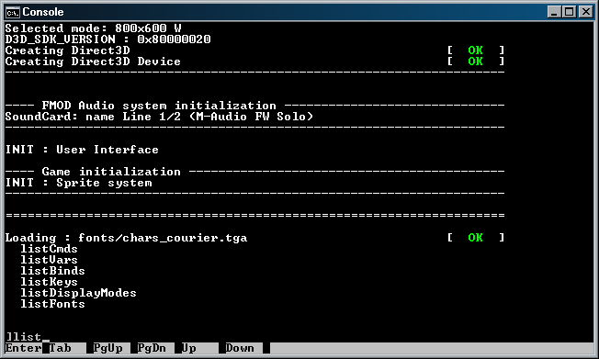
QT GUI ABSTRACTION: Console applications
Console applications are working all the time, except waiting for the user input.
User interface is: std::cin, std::cout, std::err.
If there is no platform features, application can be simply compiled to any platform

Slide 9
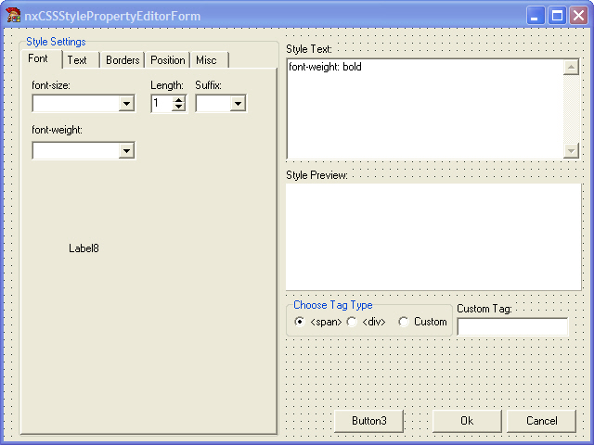
QT GUI ABSTRACTION: GUI applications
GUI applications are waiting for the user input 99% of the time.
Starts working when the user clicks the mouse button, on a keyboard input, etc.
GUI applications architecture depends on the platform.

Slide 10
QT GUI ABSTRACTION: WINDOWS GUI applications
Windows GUI applications based on messages:
Any user input produce a message: WM_KEYUP, WM_MOUSEMOVE, etc.
A lot of other messages can be handled in the application:
WM_PAINT
WM_TIMER
etc.

Slide 11
QT GUI ABSTRACTION: LINUX GUI applications
Linux GUI applications (X11):
Are based on client-server architecture.
There are many protocols, libraries and tools.
GUI visualization depends on Window Manager – KDE, Gnome.

Slide 12
QT GUI ABSTRACTION: QT GUI applications
Qt has its own GUI abstraction over platform abstraction:
Any GUI (and non-GUI) component can have slots and signals.
A slot is a simply signals handler, a signal is something like event.
A slot can be subscribed to a signal.

Slide 13
QT Ecosystem
Qt Modules (libraries) for all platforms: Qt GUI, Qt Network, Qt SQL, etc.
Qt Add-ons (libraries) for additional features support: Qt Canvas 3D, Qt Graphical Effects, Qt Printing, Windows/Linux Extras, etc.
Qt Value-Add Modules: Qt Charts, Qt for Device Creation, etc.
Qt dialect of C/C++
IDE and tools: Qt Creator, moc, qmake, Qt Designer
Projects are compiled by third-party compilers: GCC, MSVС, MinGW, Clang
Notes:
GCC – for Linux platform
MSVC and MinGW – Windows
Clang – for OS X, iOS
and others for mobile devices

Slide 14
QT Ecosystem: QT Modules
Qt Core
Qt GUI
Qt Multimedia
Qt Multimedia Widgets
Qt Network
Qt QML
Qt Quick
Qt Quick Controls
Qt Quick Dialogs
Qt Quick Layouts
Qt SQL
Qt Test
Qt Widgets

Slide 15
QT Ecosystem: QT ADD-ONS
Active Qt
Qt Android Extras
Qt Bluetooth
Qt Canvas 3D
Qt Concurrent
Qt D-Bus
Qt Graphical Effects
Qt Location
Qt Positioning
Qt Mac Extras
Qt Platform Headers
Qt Print Support
Qt Quick Extras
Qt Sensors
Qt Serial Port
Qt SVG
Qt WebChannel
Qt WebEngine
Qt WebSockets
Qt WebView
Qt Windows Extras
Qt X11 Extras
Qt XML
Qt XML Patterns

Slide 16
QT Ecosystem: QT VALUE-ADD Modules
Qt for Device Creation
Qt Charts
Qt Quick Compiler
Qt Data Visualization
Qt Purchasing
Qt Virtual Keyboard
Qt Quick 2D Renderer

Slide 17
QT Ecosystem: QT Creator & MS VS 20**
There are two popular ways to develop Qt applications:
Using Qt Creator
Using Microsoft Visual Studio 20** with Qt Add-In

Slide 18
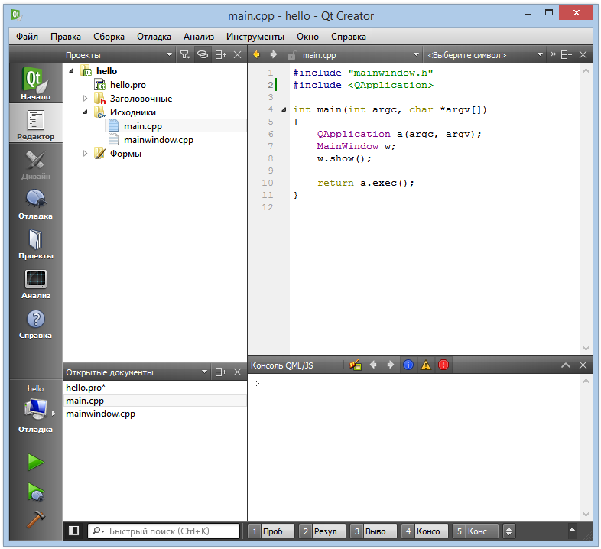
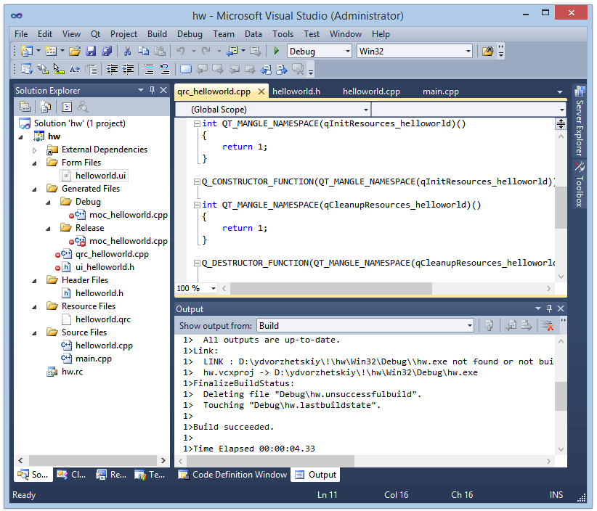
QT Ecosystem: QT Creator & MS VS 20**
Qt Creator:
Microsoft Visual Studio 20**

Slide 19
QT Ecosystem: QT Creator & MS VS 20**
Qt Creator:
qmake is used to build project
.pro-files to configure qmake
allows you create reusable in IDE UI-components
available on all platforms
Microsoft Visual Studio 20**
qmake is not used
you can create .pro-files to build project on other platforms
a lot of MS VS features
Windows only

Slide 20
QT Ecosystem: QMAKE
qmake is tool to generate a makefile for compilers
Third-party compilers (MinGW, Clang, GCC) use this generated makefile to compile project
qmake is configured by the project .pro-file

Slide 21
QT Ecosystem: .PRO-FILE
Specifies Qt modules for the project
Specifies Qt version for the project
Contains information about project sources
# QT modules for project QT += core gui
# QT version greaterThan(QT_MAJOR_VERSION, 4): QT += widgets
# Output configuration
TARGET = hello-world TEMPLATE = app
# sources, headers, forms SOURCES += main.cpp\
mainwindow.cpp HEADERS += mainwindow.h FORMS += mainwindow.ui

Slide 22
QT Ecosystem: C++ dialect
Qt sources have its own keywords and macros
slots
signals
emit
Q_OBJECT
This sources can’t be compiled directly by C++ compiler
class MainWindow : public QMainWindow
{
Q_OBJECT
public:
explicit MainWindow(QWidget *parent = 0);
~MainWindow();
public slots:
void setValue(int value);
signals:
void valueChanged(int newValue);
private:
Ui::MainWindow *ui;
};

Slide 23
QT Ecosystem: Meta-Object COMPILER
moc (Meta Object Compiler) is a tool to transform C++ sources with Qt keywords to standard C++ sources
If you use qmake, the moc call performs automatically if required.
moc processes other macros
Q_PROPERTY, Q_ENUMS, Q_CLASSINFO, etc.
moc starts from header file and transforms both .h and .cpp
Q_OBJECT macro in a header file tells that class has to be processed by moc

Slide 24
QT Ecosystem: OTHER TOOLS
uic – UI compiler, compiles .ui files to C++ sources.
rcc processes resources files.
linguist – tool for projects localization.
makeqpf creates pre-rendered fonts for embedded devices.

Slide 25
QT OVERVIEW: SUMMARY
Qt Framework
Qt Modules
Qt GUI abstraction – slots and signals
qmake, .pro-files
Qt C++ dialect
moc

Slide 26
QT OVERVIEW
QUESTIONS?

Slide 27
QT OVERVIEW: DEMO
DEMO: Working with Qt Creator

Slide 28
QT OVERVIEW: Exercise
Exercise #1
Creating simple Qt applications in Qt Creator
Discuss.

Slide 29
QT OVERVIEW
QUESTIONS?

Slide 30
Section 2: QT LANGUAGE

Slide 31
QT LANGUAGE: Notation
Qt uses camelCase notation:
void printInfo(…) – methods
int xPosition; – fields and variables
class MyClass {…} – classes
QDialog – Qt Framework classes
Q_OBJECT – macros
Getters/setters has special notation:
int age() – getters
void setAge(int age) – setters

Slide 32
QT CORE
Qt Core – module with common classes, definitions and core functionality:
Qt data types,
Slots and signals mechanism, QObject definition, Meta-Object mechanism
Qt Containers, QString, other utility classes
Multithreading, IO Classes
JSON transformation and other key frameworks

Slide 33
QT CORE
To include Qt Core definitions:
#include <QtCore>
This header is included in all other Qt Modules
Qt Core module is included in .pro-files by default:
QT += core

Slide 34
QT LANGUAGE: DATA TYPES
Qt types
qint8 | 8-bit signed integer
quint8 | 8-bit unsigned integer
qint16 | 16-bit signed integer
quint16 | 16-bit unsigned integer
qint32 | 32-bit signed integer
quint32 | 32-bit unsigned integer
qint64, qlonglong | 64-bit signed integer
quint64, qulonglong | 64-bit unsigned integer

Slide 35
QT LANGUAGE: DATA TYPES
Qt types
quintptr | Unsigned address, represents pointer, (32- or 64-bit, according to platform)
qintptr, qptrdiff | Signed address, represents pointers diff, (32- or 64-bit, according to platform)
qreal | typedef for double, typedef for float on ARM-platforms
uchar | typedef for unsigned char
ushort | typedef for unsigned short
uint | typedef for unsigned int
unlong | typedef for unsigned long

Slide 36
QT LANGUAGE: DATA TYPES
Use int where size of variable does not matter
But uint for unsigned variables
Use quintptr/qintptr for array indexes and hashes only, not for pointer types
Qt data types are defined in <QtGlobal> header in core module

Slide 37
QT LANGUAGE: KEYWORDS
Qt keywords slots, signals, and emit are not C++ keywords.
moc translates these keywords to standard C++ keywords
You can disable these keywords:
add CONFIG += no_keywords in your .pro-file
use macros Q_SIGNALS (or Q_SIGNAL), Q_SLOTS (or Q_SLOT), and Q_EMIT.

Slide 38
QOBJECT
You have to derive your class from QObject if you want use slots and signals (or other Qt functionality).
QObject is the base class for most Qt objects
All GUI components are derived from QObject
// Class derived from QObject
class BankAccount : public QObject
{
Q_OBJECT
public:
BankAccount(QObject *parent = Q_NULLPTR);
~BankAccount();
public slots:
void withdraw(long amount);
void deposit(long amount);
signals:
void balanceChanged(long newBalance);
private:
long balance;
};

Slide 39
QOBJECT
QObject provides us:
meta-object information
slots and signals
names of instances
properties
hierarchy mechanism
events handling
some timer functions
Header file:
#include <QObject>
In .pro-file:
QT += core
All QObject methods are reentrant and some are thread-safe

Slide 40
QOBJECT: MOC LIMITATIONS
Place Q_OBJECT macro in first line in your class.
Class templates and nested classes cannot have signals or slots.
Only signals and slots may appear in the signals and slots sections of a class.
In case of multiple inheritance, QObject must be placed first:
class MyClass : public QDialog, public Foo, public Bar { }
Multiple inheritance from QObjects is deny.
Virtual inheritance from QObject is deny too.

Slide 41
QOBJECT: HIERARCHY
// bankclient.h
#include <QtCore>
class BankClient : public QObject
{
Q_OBJECT
public:
BankClient(QObject *parent = Q_NULLPTR);
~BankClient();
public slots:
signals:
private:
// ...
};
// bankclient.cpp
#include "bankclient.h"
BankClient::BankClient(QObject *parent)
: QObject(parent)
{
// ...
}

Slide 42
QOBJECT: HIERARCHY
QObject provides us parent-child mechanism to constructs objects hierarchy.
There is no common with an inheritance.
Any Qt object can have a parent.
If your add pointer to the parent, the parent automatically add your object to its own children list.

Slide 43
QOBJECT: HIERARCHY
You can set a parent in the constructor.
The parent can be accessed/changed:
QObject* QObject::parent() const;
void QObject::setParent(QObject *parent);
This mechanism is used by GUI components.

Slide 44
QOBJECT: HIERARCHY
// Without hierarchy
BankClient *client1
= new BankClient;
BankClient *client2
= new BankClient;
// ...
delete client1;
delete client2;
// With hierarchy
BankClient *client1
= new BankClient;
BankClient *client2
= new BankClient(client1);
// ...
delete client1;

Slide 45
QOBJECT: HIERARCHY
Parent destroys all his children in its destructor
You can dump all tree info from parent:
void QObject::dumpObjectTree()

Slide 46
QOBJECT: NAMES
You can give your Qt Object a name:
yourObject.setObjectName("frontButton")
qDebug() << yourObject.objectName();
All UI components on forms have names.
You can find objects by name in hierarchy:
QPushButton *button = parentWidget->findChild<QPushButton *>("button1");

Slide 47
QOBJECT: IDENTITIES CONCEPTS
There are some problems:
What name should be in cloned object?
What location in hierarchy should be in cloned object?
How signals and slots are connected in cloned object?
Qt Object Model tells that Qt Objects are identities, not values:
Values are copied or assigned.
Identities are cloned – this is more complex operation, means creating new identity, not an exact copy of the old one. They have private copy constructor and assignment operator and cannot be copied.

Slide 48
QOBJECT: META-OBJECTS
Meta-Objects mechanism is similar to meta-classes in Java and .NET
You can get current class meta-information:
qDebug() << a.metaObject()->className();
You can simple check inheritance to specified class
if (a->inherits("MyClass1")) { ... }
This approach is more faster than RTTI

Slide 49
QOBJECT: QOBJECT_CAST
#include <QObject>
class GrandPa : public QObject {
Q_OBJECT
public:
GrandPa() {};
int age() {
return _age;
}
void setAge(int age) {
this->_age = age;
}
private:
int _age;
// ...
};
// dynamic_cast analog
QObject *a = new GrandPa;
qDebug() <<
qobject_cast<GrandPa*>(a)->age();

Slide 50
QDEBUG
qDebug() – is a special stream to output debug information.
You can format output stream.
You can output your own types.
For console applications – it writes to console, for GUI – to debug output.
qWarning(), qCritical() and qFatal() functions are similar to qDebug() function.
#include <QDebug>
int main(int argc, char *argv[]) {
// ...
qDebug() << "This is main function";
qDebug() << "argc is: " << argc;
// ...
}

Slide 51
QT LANGUAGE: SUMMARY
Qt keywords
QObject, syntax, moc limitations
Qt Objects hierarchy
Qt Object names
Identities concepts
Meta-Object mechanism
qobject_cast

Slide 52
QT LANGUAGE
QUESTIONS?

Slide 53
QT LANGUAGE: Exercise
Exercise #2
Creating QObjects hierarchy.
Discuss.

Slide 54
QT LANGUAGE
QUESTIONS?

Slide 55
Section 3: CONTAINERS AND QSTRING

Slide 56
CONTAINERS
Qt Containers is an analog of STL containers.
Qt Containers are also based on C++ templates.
You may store any objects and base data types in containers.
Qt Containers are not derived from QObject.
These container classes are designed to be lighter, safer, and easier to use than the STL containers.
All methods are reentrant and thread-safe in readonly operation.

Slide 57
CONTAINERS
QList<T>
QLinkedList<T>
QVector<T>
QStack<T>
QQueue<T>
QSet<T>
QMap<K, T>
QMultiMap<K, T>
QHash<K, T>
QMultiHash<K, T>

Slide 58
CONTAINERS: COMPLEXITY
Container | Index lookup | Insertion | Prepending | Appending
QLinkedList<T> | O(n) | O(1) | O(1) | O(1)
QList<T>, QQueue<T> | O(1) | O(n) | Amort. O(1) | Amort. O(1)
QVector<T>, QStack<T> | O(1) | O(n) | O(n) | Amort. O(1)

Slide 59
CONTAINERS: COMPLEXITY
Container | Key lookup (average) | Key lookup (worst case) | Insertion (average) | Insertion (worst case)
QMap<K,T>, QMultiMap<K,T> | O(log n) | O(log n) | O(log n) | O(log n)
QHash<K,T> | Amort. O(1) | O(n) | Amort. O(1) | O(n)
QSet<K> | Amort. O(1) | O(n) | Amort. O(1) | O(n)

Slide 60
CONTAINERS
To use containers add following includes:
#include <QList>
or #include <QLinkedList>
etc.
And in .pro-file:
QT += core

Slide 61
CONTAINERS: QList
Add an element to QList:
operator <<
operator +=
insert method
prepend method
append method
using iterators
Remove from QList:
operator -=
removeAt method
removeFirst method
removeLast method
removeAll method
using iterators

Slide 62
CONTAINERS: QLIST
QList<int> list1;
list1 << -2 << -1 << 0;
qDebug() << list1;
QList<int> list2;
for (int i = 0; i < 10; ++i) list2 += i + 1;
qDebug() << list2;
QList<int> list3;
list3 = list1 + list2;
qDebug() << list3;
list3.prepend(-3);
qDebug() << list3.first();
list1.last() = -1;
qDebug() << list1;
What will be displayed?

Slide 63
CONTAINERS: ITERATORS
You can use one of two types of iterators:
STL-style iterators
Java-style iterators
There are methods to convert Qt containers to STL containers.

Slide 64
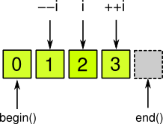
CONTAINERS: STL-STYLE ITERATORS
QList<QString> list;
list << "A" << "B" << "C" << "D";
QList<QString>::iterator i;
for (i = list.begin(); i != list.end(); ++i)
*i = (*i).toLower();

Slide 65
CONTAINERS: STL-STYLE ITERATORS
Container | Read-only iterator | Read-write iterator
QList<T>, QQueue<T> | QList<T>::const_iterator | QList<T>::iterator
QLinkedList<T> | QLinkedList<T>::const_iterator | QLinkedList<T>::iterator
QVector<T>, QStack<T> | QVector<T>::const_iterator | QVector<T>::iterator
QSet<T> | QSet<T>::const_iterator | QSet<T>::iterator
QMap<K,T>, QMultiMap<K,T> | QMap<K,T>::const_iterator | QMap<K,T>::iterator
QHash<K,T>, QMultiHash<K,T> | QHash<K,T>::const_iterator | QHash<K,T>::iterator

Slide 66
CONTAINERS: STL-STYLE ITERATORS
Expression | Description
list.begin() | Returns STL-iterator to the first element
list.end() | Returns STL-iterator to the virtual last element
list.constBegin() | Returns const STL-iterator to the first element
list.constEnd() | Returns const STL-iterator to the virtual last element
list.rbegin() | Returns reverse STL-iterator to the first element
list.rend() | Returns reverse STL-iterator to the virtual last element
list.rcbegin() | Returns reverse const STL-iterator to the first element
list.rcend() | Returns reverse const STL-iterator to the virtual last element

Slide 67
CONTAINERS: STL-STYLE ITERATORS
Expression | Description
*i | Reference to the current element
i + n | Returns iterator at n elements forward
++i, i++ | Moves iterator forward
i += n | Moves iterator forward to n elements
i - n | Returns iterator at n elements backward
--i, i-- | Moves iterator backward
i += n | Moves iterator backward to n elements
i - j | Number of elements between i and j
i < j | Compares two iterators
i[n] | The same as *(i+n)

Slide 68
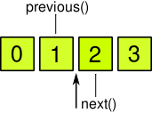
CONTAINERS: JAVA-STYLE ITERATORS
QList<QString> list;
list << "A" << "B" << "C" << "D";
QMutableListIterator<QString> i(list);
while (i.hasNext())
i.next().toLower();

Slide 69
CONTAINERS: JAVA-STYLE ITERATORS
Container | Read-only iterator | Read-write iterator
QList<T>, QQueue<T> | QListIterator<T> | QMutableListIterator<T>
QLinkedList<T> | QLinkedListIterator<T> | QMutableLinkedListIterator<T>
QVector<T>, QStack<T> | QVectorIterator<T> | QMutableVectorIterator<T>
QSet<T> | QSetIterator<T> | QMutableSetIterator<T>
QMap<K,T>, QMultiMap<K,T> | QMapIterator<K,T> | QMutableMapIterator<K,T>
QHash<K,T>, QMultiHash<K,T> | QHashIterator<K,T> | QMutableHashIterator<K,T>

Slide 70
CONTAINERS: JAVA-STYLE ITERATORS
Expression | Description
i.next() | Returns reference to the next element, moves forward
i.hasNext() | Returns false at the end, true – otherwise
i.peekNext() | Returns reference to the next element, does not mutate iterator
i.previous() | Returns reference to the previous element, moves backward
i.hasPrevious() | Returns false at the begin, true – otherwise
i.peekNext() | Returns reference to the previous element, does not mutate iterator
i.toFront() | Moves iterator to the begin
i.toBack() | Moves iterator to the end

Slide 71
CONTAINERS: FOREACH
Qt provides foreach construction
Qt also provides forever keyword for forever loops
You can off all additional keywords writing in .pro-file:
CONFIG += no_keywords
QList<int> list;
list << 0 << 1 << 2 << 3; foreach (int x, list) {
qDebug() << x; }
QLinkedList<QString> list2;
foreach (const QString &str, list2)
qDebug() << str;
forever {
// ...
}

Slide 72
CONTAINERS: Q_DECLARE_TYPEINFO
For correct working with containers use Q_DECLARE_TYPEINFO with your class definition.
Macro definition in:
#include <QtGlobal>
In .pro-file: QT+= core
struct Point2D {
int x;
int y;
};
Q_DECLARE_TYPEINFO(Point2D, Q_PRIMITIVE_TYPE);

Slide 73
CONTAINERS: Q_DECLARE_TYPEINFO
Q_DECLARE_TYPEINFO arguments:
Q_PRIMITIVE_TYPE – type without constructor and destructor, or if memcpy creates correct copy of object.
Q_MOVABLE_TYPE – type with constructor and/or destructor and memcpy creates correct copy of object.
Q_COMPLEX_TYPE (default) – has constructors and/or a destructor and it may not be moved in memory.

Slide 74
QVARIANT
QVariant is an analog of C++ union
QVariant can be used in collections to store different types
QVariant can be used with non-Qt types:
add Q_DECLARE_METATYPE(NonQtClass *) macro

Slide 75
QVARIANT
// With C++ union
typedef union {
int m_int;
long m_long;
double m_double;
} Number;
Number num;
num.m_int = 1;
num.m_long = 2L;
num.m_double = 3.0;
// With QVariant
QVariant v;
v.setValue(1);
v.setValue(2L);
v.setValue(3.0);

Slide 76
QVARIANT: VALID AND NULL
QVariant has additional states:
valid/invalid – if type of QVariant is set/not set
not null/null – if value of QVariant is set/not set
QVariant a;
qDebug() << a.isValid(); // false
qDebug() << a.isNull(); // true
QVariant b(QVariant::Int);
qDebug() << b.isValid(); // true
qDebug() << b.isNull(); // true
QVariant c(42);
qDebug() << c.isValid(); // true
qDebug() << c.isNull(); // false

Slide 77
QT CONTAINERS: Container-Like CLASSES
QVarLengthArray<T,n>
QCache<K,T>
QContigousCache<T>
QPair<T1,T2>
QBitArray
QByteArray
QString
QStringList

Slide 78
QVARLENGTHARRAY: PROBLEM
// C++ wrong expression
int myfunc(int n) {
int table[n + 1]; // WRONG
// ...
return table[n];
}
// With heap allocation
int myfunc(int n) {
int *table = new int[n + 1]; // SLOW
// ...
int ret = table[n];
delete[] table;
return ret;
}

Slide 79
QVARLENGTHARRAY
QVarLengthArray – array with expanded length.
First elements are allocated in stack to improve speed of allocation.
QVarLengthArray has preallocated size (template argument).
Stored value type must be assignable data type.
// Using QVarLengthArray – GOOD!
int myfunc(int n) {
QVarLengthArray<int, 1024> array(n + 1);
// ...
return array[n];
}

Slide 80
QVARLENGTHARRAY
Differences between QVarLengthArray and QVector:
QVarLengthArray's API is much more low-level than QVector.
QVarLengthArray doesn't initialize the memory if the value is a basic type.
QVarLengthArray optimized for very specific cases.

Slide 81
QCACHE
QCache – cache template, stores key-value pairs.
When inserting an object, you can specify a cost (1 by default).
Cache has a max cost limit.
When the sum of all costs exceeds the limit, QCache starts deleting objects, starting from recently less accessed.
// key type, value type, max cost
QCache<int, Employee> cache(5000);
Employee *employee = new Employee;
employee->setId(37);
employee->setName("Richard Schmit");
// key, value, cost
cache.insert(employee->id(), employee, 1);

Slide 82
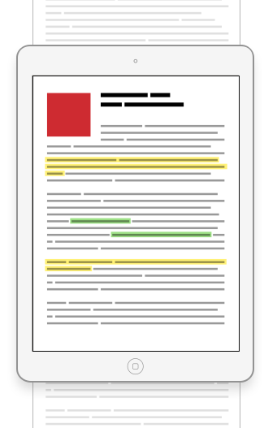
QCONTIGuOUSCACHE
QContinguousCache provides a contigous cache
Contiguous cache is an efficient way of caching items for display in a user interface.
Contiguous cache is like a view window on scrolled page

Slide 83
QCONTIGuOUSCACHE
QContigousCache<MyRecord> cache;
MyRecord record(int row) const {
Q_ASSERT(row >= 0 && row < count());
while(row > cache.lastIndex())
cache.append( slowFetchRecord(cache.lastIndex() + 1) );
while(row < cache.firstIndex())
cache.prepend( slowFetchRecord(cache.firstIndex() - 1) );
return cache.at(row);
}

Slide 84
QPAIR
QPair<T1,T2> – Qt implementation of a pair of objects.
Template data types T1 and T2 must be assignable data types.
QPair<QString, double> pair;
pair.first = "pi";
pair.second = 3.14159265358;

Slide 85
QBITARRAY
QBitArray – implementation of an array of bits.
Reduce memory usage.
Provides AND, OR, XOR, NOT operators.
QBitArray ba;
ba.resize(3);
ba[0] = true;
ba[1] = false;
ba[2] = true;
QBitArray ba(3);
ba.setBit(0, true);
ba.setBit(1, false);
ba.setBit(2, true);

Slide 86
QBYTEARRAY
QByteArray – implementation of null-terminated 8-bit string.
Provides some strings operations:
Base64 encoding
number-string conversions
strcmp, strcpy, etc.
QByteArray ba("Hello");
QByteArray ba;
ba.resize(5);
ba[0] = 0x3c;
ba[1] = 0xb8;
ba[2] = 0x64;
ba[3] = 0x18;
ba[4] = 0xca;

Slide 87
QCHAR
QChar represents 16-bit Unicode 4.0 character.
QChar provides testing/classification functions, converting to and from other formats.
QChar qChar ('a');
qDebug() << qChar;
qDebug() << qChar.isDigit();
qDebug() << qChar.isLetter();
qDebug() << qChar.isLetterOrNumber();
qDebug() << qChar.isPunct();

Slide 88
QCHAR: SPECIAL CHARACHTERS
QChar::Null – '\0', QChar with this value isNull().
QChar::Nbsp – non-breaking space.
QChar::LineSeparator – Unicode line separator.
QChar::ParagraphSeparator – Unicode paragraph separator.

Slide 89
QSTRING
QString class provides a Unicode 4.0 character string with many useful methods.
QString stores a string of 16-bit QChars.
Unicode characters above 65535 are stored using surrogate pairs of consecutive QChars.
Last character of the string is always '\0'.
QString str = "Hello";
str[4] == 'o';
str[5] == '\0';
// or
QString str;
str.resize(4);
str[0] = QChar('U');
str[1] = QChar('n');
str[2] = QChar(0x10e3);
str[3] = QChar(0x03a3);

Slide 90
QSTRING
QString uses implicit sharing (copy-on-write) to reduce memory usage.
If you want to use classical 8-bit '\0'-terminated strings – use QByteArray.
Simple conversion from and to:
char* strings;
wchar_t arrays;
std::string
STD UTF-8 and UTF-32 strings
numeric types: qulong, quint, etc. with different base

Slide 91
QSTRING
QString provides many operators.
Note that at(int) method can be faster than operator[](), because it never causes a deep copy to occur.
You can iterate string characters using STL-style iterator.
QString str = "Hello";
qDebug() << str[0];
qDebug() << str.at(1);
qDebug() << (str == "Hello world!");
qDebug() << (str < "Hello1");

Slide 92
QString: NULL AND EMPTY
QString has additional states:
null/not null – if string is set/not set
not empty/empty – if characters are set/not set.
QString().isNull(); // true QString().isEmpty(); // true
QString("").isNull(); // false QString("").isEmpty(); // true
QString("abc").isNull(); // false QString("abc").isEmpty(); // false

Slide 93
QString: NUMBERS
QString has features to convert QString to and from numeric types.
QString str1("1234");
int x = str1.toInt();
QString str2("3.14");
double y = str2.toDouble();
QString str;
str = QString::number(123);
str = QString::number(3.14);
str = QString::number(255, 16); // "FF"

Slide 94
QString: SIZE
You can get QString size through the size and the synonym length method.
You can resize the string with resize method.
Note, that '\0'-characters can be embedded in string.
QString::size returns full string size, including '\0'-characters.
QString str("Hello");
qDebug() << str.length(); // 5
qDebug() << str.size(); // 5
str[2] = '\0';
qDebug() << str.size(); // 5 !
str.resize(3);
qDebug() << str.size(); // 3

Slide 95
QString: METHODS
Method | Description
count | Counts all occurrences of the string, char, regex
append | Appends char/string after this string
prepend | Prepends char/string before this string
contains | Checks whether or not this string contains char/string/regex
replace | Replaces char/string/regex in this string
trimmed | Returns string without whitespaces at the strat and the end
remove | Removes char/string/regex from the string
toUpper/toLower | Changes case of the string

Slide 96
QString: ARG
There is something like printf function – arg method.
Place markers must be in range %1–%99.
Place markers can be appear multiple times in the string
See documentation for format output.
QString str = "%1 %2!";
// "Hello world!" str.arg("Hello", "world");
// or
str.arg("Hello").arg("world");

Slide 97
QString: ARG
Be careful with arg method!
QString str;
str = "%1 %2";
str.arg("%1f", "Hello"); // "%1f Hello"
str.arg("%1f")
.arg("Hello"); // "Hellof %2"

Slide 98
QSTRINGBUILDER
// without string builder
QString a("1111");
QString b("2222");
QString c("3333");
QString d("4444");
// 3 strings instead one will be created
QString bigString = a + b + c + d;
// with string builder
#include <QStringBuilder>
QString a("1111");
QString b("2222");
QString c("3333");
QString d("4444");
// one string will be created
QString bigString = a % b % c % d;

Slide 99
QSTRINGBUILDER
// with string builder!
QString a("1111");
QString b("2222");
QString c("3333");
QString d("4444");
// one string will be created
QString bigString = a + b + c + d;
// in .pro-file
DEFINES *= QT_USE_QSTRINGBUILDER
You can override "+" operator for working with QStringBuilder for whole project.

Slide 100
QStringLIST
QStringList represents a list of strings.
QStringList has useful for a list of strings methods:
join
sort
filter
replaceInStrings
QString line("Helvetica,Arial");
QStringList lines = line.split(",");
// or
QStringList lines;
lines << "Helvetica" << "Arial";
QString newLine = lines.join('\n');

Slide 101
QPOINTER
QPointer provides guarded pointer to QObject.
There are all pointer operations except arithmetic (--, ++, -, +)
It sets automatically to 0 when object is destroyed.
Just use as normal pointer.
The object being pointed to is not destroyed in QPointer destructor!
QPointer<QLabel> label = new QLabel;
label->setText("Status:");
// ...
if (label) label->show();
// or
if (!label.isNull()) label->show();

Slide 102
QScopeDPOINTER
QScopedPointer provides guarded pointer to QObject.
QScopedPointer will delete the pointer it is holding when it goes out of scope.
void myFunction() {
QSharedPointer<MyClass> myObject
= new MyClass();
if (myObject) {
// ...
}
} // here pointer will be deleted

Slide 103
QSHAREDPOINTER
QSharedPointer provides guarded pointer to QObject.
QSharedPointer will delete the pointer it is holding when it goes out of scope and no other QSharedPointer objects are referencing it.
MyClass *p = new MyClass();
QSharedPointer<MyClass> p1(p);
QSharedPointer<MyClass> p2 = p1;
p1.clear();
// p2 is still pointing to p
p2.clear();
// no shared pointers anymore,
// p is deleted

Slide 104
IMPLICIT DATA SHARING
A lot of Qt classes use implicit data sharing (copy-on-write).
That allows maximize resource usage and minimize copying.
QPixmap p1, p2;
p1.load("image.bmp");
p2 = p1; // p1 and p2 share data
QPainter paint;
paint.begin(&p2);
// creates copy of data and changes it
paint.drawText(0, 50, "Hi"); paint.end();

Slide 105
CONTAINERS AND QSTRING: SUMMARY
Qt Containers
STL-style iterators
Java-style iterators
Q_DECLARE_TYPEINFO
QVariant
Container-like structures
QChar
QString
QStringBuilder
QStringList
QPointer
QSharedPointer

Slide 106
CONTAINERS AND QSTRING
QUESTIONS?

Slide 107
CONTAINERS AND QSTRING: Exercise
Exercise #3
Working with QString and Containers.
Discuss.

Slide 108
CONTAINERS AND QSTRING
QUESTIONS?

Slide 109
Section 4: SIGNALS AND SLOTS

Slide 110
Signals AND SLOTS
Any GUI and non-GUI Qt component can have slots and signals.
A slot is a simply function to handle signals.
A signal is a simply template of a slot signature without implementation.
Any class signal can be emitted in the method.
A slot can be subscribed to a signal with the same signature only.
Connected slot function runs immediately when the signal is emitted.

Slide 111
Signals AND SLOTS: EXAMPLE
// bankaccount.h
class BankAccount : public QObject
{
Q_OBJECT
public:
explicit BankAccount(QObject *parent = 0);
void withdraw(long amount);
void deposit(long amount);
signals:
void balanceChanged(long newBalance);
private:
long balance;
};
// bankaccount.cpp
BankAccount::BankAccount(QObject *parent)
: QObject(parent) {}
void BankAccount::deposit(long amount) {
balance += amount;
emit balanceChanged(balance);
}
void BankAccount::withdraw(long amount) {
if (balance >= amount)
balance -= amount;
emit balanceChanged(balance);
}
// There is no signal implementation!

Slide 112
Signals AND SLOTS: EXAMPLE
// accountholder.h
class AccountHolder : public QObject {
Q_OBJECT
public:
explicit AccountHolder(
QObject *parent = 0
);
public slots:
void notifyHolder(long newBalance);
};
// accountholder.cpp
AccountHolder::AccountHolder(QObject *parent)
: QObject(parent) {}
// slot implementation void AccountHolder::notifyHolder(
newBalance
) {
qDebug()
<< "Your balance has been changed.\n"
<< "New balance: "
<< newBalance;
}

Slide 113
Signals AND SLOTS: EXAMPLE
// main.cpp
BankAccount account;
AccountHolder holder;
QObject::connect(
&account,
SIGNAL(&BankAccount::balanceChanged),
&holder,
SLOT(&AccountHolder::notifyHolder)
);
account.deposit(1000);
// Application output:
> application.exe
Your balance has been changed.
New balance: 1000

Slide 114
Signals AND SLOTS: SIGNALS
A signal can be connected to multiple slots.
A signal can be connected to the other signal.
When a signal is emitted, the slots connected to it are executed immediately.
If several slots are connected to one signal, the slots will be executed one after the other, in the order they have been connected.
Signals are public only since Qt 5.0 (they have no modifier in QObjects).

Slide 115
Signals AND SLOTS: SIGNALS
Signals must not be implemented in the .cpp file.
They can never have return types (use void).
Signals can be declared only as public functions.

Slide 116
Signals AND SLOTS: SLOTS
Any slot can be subscribed to multiple signals.
Slots are standard C++ methods and can be used normally.
Therefore, they must be implemented in .cpp file.
Slots may be private methods, but they can be invoked by any component, regardless of its access level, via a signal-slot connection.
Virtual slots are ten times slower than non-virtual.

Slide 117
Signals AND SLOTS: MOC LIMITATIONS
moc has several limitations:
Class templates and nested classes cannot have signals or slots.
Function pointers cannot be signals or slots parameters.
Enums and typedefs must be fully qualified for signal and slot parameters.
Signal/Slot return types cannot be references.
Only signals and slots may appear in the signals and slots sections of a class.

Slide 118
Signals AND SLOTS: ADVANTAGES
Signals and slots are type-safe.
Using of signals and slots reduces coupling between classes.
Signals and slots make your components more reusable.

Slide 119
Signals AND SLOTS: Connections
Signal: void valueChanged(int value)
Slot: void showNumber(int value) // can be connected
Signal: void valueChanged(int value)
Slot: void update() // can be connected !
Signal: void clicked()
Slot: void setValue(int value) // cannot be connected

Slide 120
Signals AND SLOTS: BEST PRACTICES
Declare signals with standard parameters where possible.
Declare slots with the minimal list of parameters where possible.
Do not declare slots as virtual functions.
Emit signals from the class that defines the signal and its subclasses.

Slide 121
SIGNALS AND SLOTS: CONNECT
To connect a signal and a slot use the static method QObject::connect
In QObject classes prefix QObject:: is redundant
Using of function pointers is recommended way.
QObject *sender = ...;
QObject *receiver = ...;
// sender, signal, receiver, slot
QObject::connect(
sender, &MyObject::mySignal,
receiver, &MyObject::mySlot
);

Slide 122
SIGNALS AND SLOTS: CONNECT
You can use the special syntax with SIGNAL and SLOT macros.
QLabel *label = new QLabel;
QScrollBar *scrollBar = new QScrollBar;
// sender, signal signature,
// receiver, slot signature
connect(
scrollBar,
SIGNAL(valueChanged(int)),
label,
SLOT(setNum(int))
);

Slide 123
SIGNALS AND SLOTS: CONNECT
You can also connect to functors or C++11 lambdas
connect(
sender, &MyObject::mySignal,
[=]() {
qDebug() << this->objectName();
}
);

Slide 124
SIGNALS AND SLOTS: CONNECT
Signals can be connected to other signals.
If the source signal emitted, then all connected signals will be emitted.
connect(
myButton, SIGNAL(clicked()),
this, SIGNAL(buttonClicked())
);

Slide 125
Signals AND SLOTS: CONNECTION TYPES
QObject::connect have an additional argument that represents a connection type.
QObject::connect(
sender, &MyObject::mySignal,
receiver, &MyObject::mySlot,
Qt::AutoConnection
);

Slide 126
Signals AND SLOTS: CONNECTION TYPEs
Qt::ConnectionType:
Qt::AutoConnection (default) – if the receiver lives in the thread that emits the signal, Qt::DirectConnection is used. Otherwise, Qt::QueuedConnection is used.
Qt::DirectConnection – the slot is invoked immediately when the signal is emitted. The slot is executed in the signalling thread.
Qt::QueuedConnection – the slot is invoked when control returns to the event loop of the receiver's thread. The slot is executed in the receiver's thread.

Slide 127
Signals AND SLOTS: CONNECTION TYPEs
Qt::ConnectionType:
Qt::BlockingQueuedConnection – same as Qt::QueuedConnection, except that the signaling thread blocks until the slot returns. This connection must not be used if the receiver lives in the signaling thread, or else the application will deadlock.
Qt::UniqueConnection – this is a flag that can be combined with any one of the above connection types, using a bitwise OR. When Qt::UniqueConnection is set, QObject::connect will fail if the connection already exists.

Slide 128
SIGNALS AND SLOTS: DISCONNECT
QObject::disconnect is used to disconnect signal and slot
returns true if connection successfully broken
0 can be used as wildcard
QObject *sender = ...;
QObject *receiver = ...;
// sender, signal, receiver, slot
QObject::disconnect(
sender, SIGNAL(...),
receiver, SLOT(...)
);

Slide 129
SIGNALS AND SLOTS: DISCONNECT
Disconnect everything connected to an object's signals.
QObject *myObject = ...;
// sender, signal, receiver, slot
disconnect(myObject, 0, 0, 0);
// or
myObject->disconnect();

Slide 130
SIGNALS AND SLOTS: DISCONNECT
Disconnect everything connected to a specific signal.
QObject *myObject = ...;
// sender, signal, receiver, slot
disconnect(
myObject, SIGNAL(mySignal()),
0, 0
);
// or
myObject->disconnect(
SIGNAL(mySignal())
);

Slide 131
SIGNALS AND SLOTS: DISCONNECT
Disconnect a specific receiver
QObject *myObject = ...;
// sender, signal, receiver, slot
disconnect(
myObject, 0,
myReceiver, 0
);
// or
myObject->disconnect(
myReceiver
);

Slide 132
SIGNALS AND SLOTS: DISCONNECT
QObject::connect returns QMetaObject::Connection which can be used for disconnect
QMetaObject::Connection conn =
QObject::connect(...);
QObject::disconnect(conn);

Slide 133
SIGNALS AND SLOTS: QObject
All QObjects have a special signal: destroyed.
This signal is emitted immediately before this object is destroyed.
This signal cannot be blocked.
All the objects's children are destroyed immediately after this signal is emitted.
connect(
sender,
SIGNAL(destroyed(QObject*)),
this,
SLOT(...)
);

Slide 134
SIGNALS AND SLOTS: QObject
All QObjects have public slot: deleteLater.
It schedules this object for deletion.
Works correctly only in the event loop.
It is safe to call this function more than once.
void QObject::deleteLater()

Slide 135
SIGNALS AND SLOTS: BLOCKING SIGNALS
You can block/unblock all signals emitted by this object using blockSignals(true/false).
Note that the destroyed() signal will be emitted even if the signals for this object have been blocked.
void BankAccount::withdraw(long amount) {
if (balance < 0)
this->blockSignals(true);
balance -= amount
// signal does not be emitted
// if balance is negative
emit balanceChanged(balance);
}

Slide 136
SIGNALS AND SLOTS: SUMMARY
Slots and signals mechanism
moc limitations
How to connect slots and signals
Connection types
How to disconnect slots and signals
QObjects signals and slots

Slide 137
SIGNALS AND SLOTS
QUESTIONS?

Slide 138
SIGNALS AND SLOTS: Exercise
Exercise #4
Working with Signals and Slots.
Discuss.

Slide 139
SIGNALS AND SLOTS
QUESTIONS?

Slide 140
Section 5: GUI WIDGETS

Slide 141
QWIDGET
QWidget is the base class of all user interface objects.
QWidget inherits QObject and its features: slots and signals, objects hierarchy.
There is no difference between containers and components in Qt GUI model. All QWidgets can contain child elements.
Every widget is rectangular, and they are sorted in a Z-order.
A widget is clipped by its parent.

Slide 142
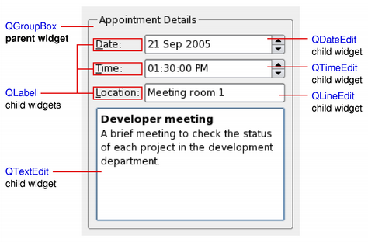
QWIDGET: WINDOW AND CHILD WIDGETS
A top-level widget that is not embedded in a parent widget is called a window.
Non-window widgets are child widgets, displayed within their parent widgets.
Window widget usually has a frame and a window title

Slide 143
QWIDGET: WINDOW CLASSES
To create window widgets you have to derive from:
QMainWindow is the application's main user interface. QMainWindow has its own layout to which you can add a menu bar, tool bars, dockable widgets and a status bar, or any kind of QWidget in center area.
QDialog is used as secondary window that present the user with options and choices.

Slide 144
QWIDGET: WINDOW METHODS
Method | Description
isWindow | Returns true if widget is window
parentWidget | Returns the parent widget or 0 for window
setParent | Sets the parent widget
window | Returns the window for this widget
windowTitle/setWindowTitle | Returns/sets the window title
windowTitleChanged | (signal) Signals about changing of the window title
windowIcon/setWindowIcon | Returns/sets the window icon
windowIconChanged | (signal) Signals about changing of the window icon

Slide 145

QWIDGET: WINDOW
Show/hide functions are common for all widgets.
But windows has special functions to show it.
This functions have same behavior as standard window buttons.

Slide 146
QWIDGET: WINDOW METHODS
Method | Description
show/setVisible(true) | Shows the widget and its child widgets
hide/setVisible(false) | Hides the widget and its child widgets
isVisible | Returns true if the window is visible
isHidden | Returns false if the window is visible
showFullScreen | Shows window in full-screen mode
showNormal | Restores the widget after it has been maximized or minimized
showMinimized | Shows the window minimized, as an icon
showMaximized | Shows the widget maximized

Slide 147
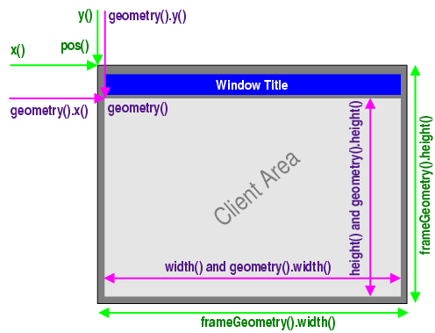
QWIDGET: WINDOW GEOMETRY
QWidget provides special methods to work with size and position of top-level windows.
QPoint, QSize, QRect classes are used in these methods.

Slide 148
QWIDGET: WINDOW GEOMETRY
Method | Description
x(), y(), pos() | The left-top point of the whole window including the window frame
frameGeometry().width(), frameGeometry().height() | The size of the whole window including the window frame
frameGeometry() | The rect of the whole window including the window frame
geometry().x() geometry().y() | The left-top point of the client area excluding the window frame
height(), width(), geometry().height() geometry().width() | The size of the client area excluding the window frame
geometry() | The rect of the client area excluding the window frame

Slide 149
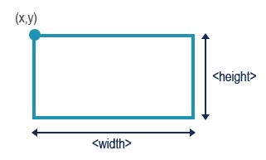
QWIDGET: CHILD WIDGETS GEOMETRY
For child widgets frameGeometry() is the same as geometry()

Slide 150
QWIDGET: CHILD WIDGETS GEOMETRY
Method | Description
x(), y(), pos() | The left-top point position of the widget relative to its parent
width(), height() | The size of the widget
geometry() | The rect of the widget relative to its parent

Slide 151
QWIDGET: CHANGE GEOMETRY
QWidget has methods to change the geometry.
These methods works for the top-level widgets and the child widgets.
Method | Description
move(13,19) | Moves the widget to new position
resize(100, 200) | Resizes the widget without moving
setGeometry(…) | Sets the whole widget geometry

Slide 152
WIDGETS: Qt GUI and QT WIDGETS
Qt GUI:
QtGuiApplication, QWindow
2D Graphics
Open GL integration
Drag and Drop
#include <QtGui>
QT += gui
Qt Widgets (will be covered):
QMainWindow, QDialog
A lot of UI widgets
Dialogs
Styles, Layouts
Model/View Classes
#include <QtWidgets>
QT += widgets

Slide 153
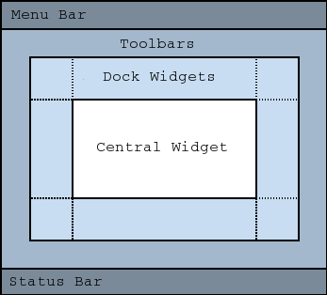
WIDGETS: QMainAPPLICATION
QMainApplication can contains:
QMenuBar
QStatusBar
QToolBars
QDockWidgets
Any QWidget as central widget:
QMdiArea for MDI applications
QGraphicView for viewing graphics
etc.

Slide 154
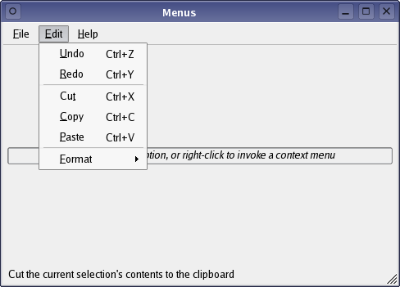
WIDGETS: ACTIONS
Every application has its special actions that it user can do.
Any Action may be called differently:
By pressing a hot key
By clicking on menu item
By clicking on toolbar
But there is only one action that program will do.

Slide 155
WIDGETS: QACTIONS
QAction provides interface for actions.
It is recommend that actions are created as children of the window they are used in (e.g. QMainWindow).
// on init
const QIcon openIcon = QIcon::fromTheme(
"document-open", QIcon(":/open.png"));
QAction *openAct = new QAction(openIcon,
"&Open...", this);
openAct->setShortcuts(QKeySequence::Open); openAct->setStatusTip("Open a file");
connect(
openAct, &QAction::triggered,
this, &MainWindow::open
); fileMenu->addAction(openAct);
fileToolBar->addAction(openAct);
// action method
void MainWindow::open() { /*...*/ }

Slide 156
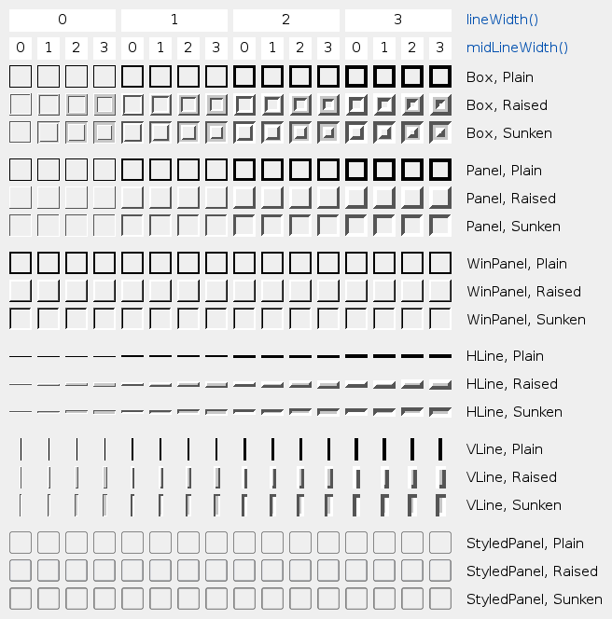
WIDGETS: QFRAME
QFrame is the base class of widgets that can have a frame.
Note that different platforms may not use inset/outset features.
Use standard settings for correct cross-platform GUI.

Slide 157
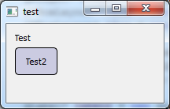
WIDGETS: QLABEL
QLabel is a simple widget that provides a text or image display.
QLabel is derived from QFrame so it can have frame.
QLabel *label = new QLabel(this);
label->setFrameStyle(
QFrame::Panel | QFrame::Sunken
);
label->setText("first line\nsecond line"); label->setAlignment(
Qt::AlignBottom | Qt::AlignRight
);

Slide 158
WIDGETS: QLabel
QLabels are often used as a label for an interactive widget.
These interactive widgets are calling buddies.
QLabel provides a useful mechanism for adding an mnemonic that will set the keyboard focus to the other widget.
QLineEdit *phoneEdit = new QLineEdit(this);
// this line adds "Alt + Q" shortcut
QLabel *phoneLabel = new QLabel(
"&Phone:", this
);
phoneLabel->setBuddy(phoneEdit);

Slide 159
WIDGETS: QLABEL CONTENT
Content | How to set
Plain text | Pass a QString to setText()
Rich text (with text HTML tags) | Pass a QString that contains rich text to setText()
A pixmap | Pass a QPixmap to setPixmap()
A movie | Pass a QMovie to setMovie()
A number | Pass an int or a double to setNum(), which converts the number to plain text
Nothing | The same as an empty plain text. This is the default. Set by clear()

Slide 160
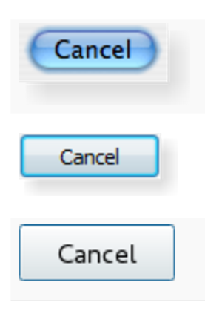
WIDGETS: QPushButton
QPushButton provides a command button.
Typical buttons are OK, Apply, Cancel, Close, Yes, No and Help.
QPushButton *button =
new QPushButton("&Download", this);
// "Alt + D" shortcut will be added

Slide 161
WIDGETS: QPushButton
QPushButtons are displayed with text label, but you can add icon using setIcon() method.
QPushButtons can emit following signals:
clicked() – commonly used
pressed()
released()
QObject::connect(
closeButton,
&QPushButton::clicked,
this,
&MyForm::close
);

Slide 162
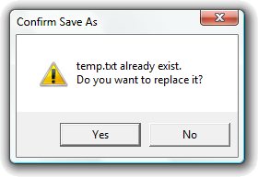
WIDGETS: QPushButton
QPushButtons can de default
A default button is a push button that is activated when the user presses the Enter or Return key in a dialog.
Use setDefault/setAutoDeault methods to set default state.
More useful methods are inherited from QAbstractButton – parent for all buttons.

Slide 163
WIDGETS: QPushButtons States
State | How to set/check
Available or not (grayed out, disabled) | setEnabled()/isEnable()
Standard/toggling push button | setCheckable()/isCheckable()
Menu button (with dropdown) | setMenu()
On or off (for toggle buttons) | setChecked()/isChecked()
Default or normal | setDefault()/isDefault()
Autorepeat or not | setAutoRepeat()/isAutoRepeat()
Pressed down or not | setDown()/isDown()

Slide 164
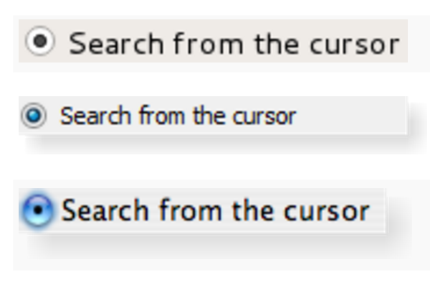
WIDGETS: QRADIOButton
QRadioButton widget provides a radio button with a text label.
A QRadioButton is an option button that can be switched on (checked) or off (unchecked). Radio buttons typically present the user with a "one of many" choice.

Slide 165
WIDGETS: QRADIOBUTTON
Whenever a button is switched on or off, it emits the toggled() signal. Connect to this signal if you want to trigger an action each time the button changes state. Use isChecked() to see if a particular button is selected.
QRadioButton *radioButton
= new QRadioButton(
"Search from the &cursor",
this
);
QObject::connect(
radioButton,
&QRadioButton::toggled,
this, &MyForm::onChoice
);

Slide 166
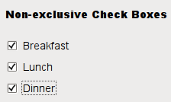
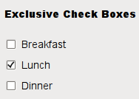
WIDGETS: QCheckBox
QCheckBox widget provides a checkbox with a text label.
A QCheckBox is an option button that can be switched on (checked) or off (unchecked). Checkboxes are typically used to represent features in an application that can be enabled or disabled without affecting others.

Slide 167
WIDGETS: QCHECKBOX
Whenever a button is switched on or off, it emits the stateChanged() signal.
Use isChecked() to see if a particular button is selected.
QCheckBox *checkBox
= new QCheckBox(
"C&ase sensitive",
this
);
QObject::connect(
checkBox,
&QCheckBox::stateChanged,
this, &MyForm::onChoice
);

Slide 168
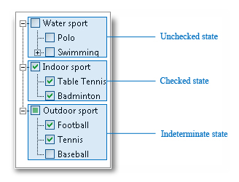
WIDGETS: QCHECKBOX
QCheckBox widget can be in three states.
This is useful in tree of checkboxes.
Use setTristate()/isTristate() to allow this.

Slide 169
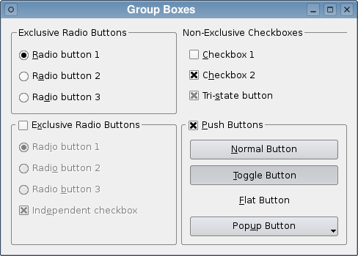
WIDGETS: QGROUPBOX
Radio buttons, exclusive checkboxes are useful only in group.
You can group other buttons to add features.
QGroupBox provides interface for that.

Slide 170
WIDGETS: QGROUPBOX EXAMPLE
QGroupBox *groupBox = new QGroupBox("Exclusive Radio Buttons", this); QRadioButton *radio1 = new QRadioButton("&Radio button 1");
QRadioButton *radio2 = new QRadioButton("R&adio button 2");
QRadioButton *radio3 = new QRadioButton("Ra&dio button 3");
radio1->setChecked(true);
QVBoxLayout *vbox = new QVBoxLayout;
vbox->addWidget(radio1);
vbox->addWidget(radio2);
vbox->addWidget(radio3);
groupBox->setLayout(vbox);

Slide 171
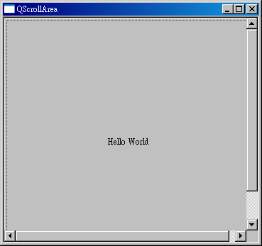
WIDGETS: QSCROLLAREA
QScrollArea is another GUI container, provides a scrolling view onto another widget.
You can setHorizontalScrollBarPolicy() setHorizontalScrollBarPolicy():
Qt::ScrollBarAsNeeded
Qt::ScrollBarAlwaysOff
Qt::ScrollBarAlwaysOn

Slide 172
WIDGETS: QSCROLLAREA
It is easy to use QScrollArea.
Simply add child QWidget with setWidget().
QLabel *imageLabel = new QLabel;
QImage image("happyguy.png");
imageLabel->setPixmap(
QPixmap::fromImage(image)
);
scrollArea = new QScrollArea(this); scrollArea->setWidget(imageLabel);

Slide 173
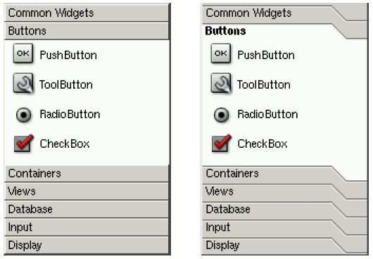
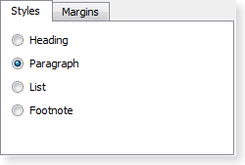

WIDGETS: OTHER CONTAINERS
QToolBox
QTabWidget
QStackedWidget

Slide 174
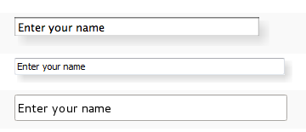
WIDGETS: QLineEdit
QLineEdit widget is a one-line text editor.
The text can be constrained with setMaxLength(), setValidator() and setInputMask().

Slide 175
WIDGETS: QLINEEDIT
Signals:
cursorPositionChanged
editingFinished
returnPressed
selectionChanged
textChanged
textEdited
You can use setText() to set text.
text() and displayText() can be different, use what you need.
There are methods for working with buffer:
setSelection(), selectAll()
insert(), copy(), paste(), cut()

Slide 176
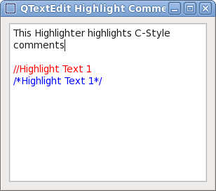
WIDGETS: QTEXTEDIT
QTextEdit provides many other features for working with text:
Multiline text
Colored text
Rich text
Tables
Images
See documentation

Slide 177
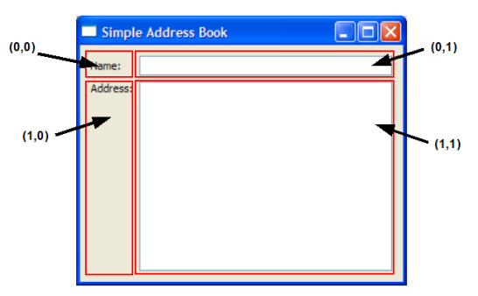
LAyouts
Forms geometry is need to be managed to look well.
The Qt layout system provides a simple and powerful way of automatically arranging child widgets within a widget.
You may specify layouts in Qt Designer or programatically.

Slide 178


LAyouts: BOX LAYOUTS
QLayout is common parent for all layouts.
You can set QLayout to any QWidget.
Here is two QBoxLayout childs:
QHBoxLayout
QVBoxLayout

Slide 179
LAYOUTS: BOX LAYOUTS
You can use QHBoxLayout programmatically
QVBoxLayout code is identical.
QWidget *window = new QWidget;
QPushButton *button1 = new QPushButton("One");
QPushButton *button2 = new QPushButton("Two");
// ...
QHBoxLayout *layout = new QHBoxLayout;
layout->addWidget(button1);
layout->addWidget(button2);
// ...
window->setLayout(layout);
window->show();

Slide 180
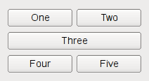
LAYOUTS: QGRIDLAYOUT
Here is the sample of QGridLayout. For each item you have to specify its virtual coordinates on form.
QWidget *window = new QWidget;
QPushButton *button1 = new QPushButton("One"); QPushButton *button2 = new QPushButton("Two");
// ...
QGridLayout *layout = new QGridLayout;
layout->addWidget(button1, 0, 0);
layout->addWidget(button2, 0, 1);
layout->addWidget(button3, 1, 0, 1, 2);
layout->addWidget(button4, 2, 0);
layout->addWidget(button5, 2, 1);
window->setLayout(layout);
window->show();

Slide 181
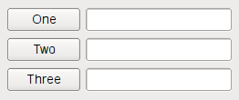
LAYOUTS: QFORMLAYOUT
QFormLayout adds two widgets on a row, commonly a QLabel and a QLineEdit to create forms.
QWidget *window = new QWidget;
QPushButton *button1 = new QPushButton("One"); QLineEdit *lineEdit1 = new QLineEdit(); QPushButton *button2 = new QPushButton("Two"); QLineEdit *lineEdit2 = new QLineEdit();
// ...
QFormLayout *layout = new QFormLayout;
layout->addRow(button1, lineEdit1);
layout->addRow(button2, lineEdit2);
layout->addRow(button3, lineEdit3);
window->setLayout(layout);
window->show();

Slide 182
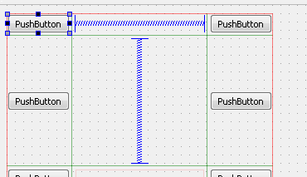
LAYOUTS: SPACERS
QSpacerItem is utility layout item that provides blank space

Slide 183
LAYOUTS: DEMO
Demo:
Qt Designer Toolbox
Available widgets
Widgets properties, slots and signals
Layouts in Qt Designer
Spacing in Qt Designer

Slide 184
GUI WIDGETS: SUMMARY
QWidget
Widgets geometry
Windows
QMainWindow, actions
QLabel
QPushButton
QRadioButton, QCheckBox
QGroupBox
QScrolArea
Other GUI containers
QLineEdit, QTextEdit
Layouts, spacers

Slide 185
GUI WIDGETS
QUESTIONS?

Slide 186
GUI WIDGETS: Exercise
Exercise #5
Working with GUI widgets.
Discuss.

Slide 187
GUI WIDGETS
QUESTIONS?

Slide 188
Section 6: PROPERTIES

Slide 189
PROPERTIES
Qt provides its own property system.
compiler independent
works on any platform
based on meta-type system
has integration with slots and signal

Slide 190
PROPERTIES: EXAMPLE
// Sample from QWidget sources
class QWidget : public QObject {
Q_OBJECT
// ...
Q_PROPERTY(bool focus READ hasFocus)
Q_PROPERTY(bool enabled READ isEnabled WRITE setEnabled)
Q_PROPERTY(QCursor cursor READ cursor WRITE setCursor RESET unsetCursor)
// ...
}

Slide 191
PROPERTIES
Properties are set in class declaration.
Can be declared in QObjects only.
Properties are declared using the macro Q_PROPERTY.
Properties are inherited by derived classes. In case of the multiple inheritance they must come from the first inherited class.
Property can be any type (through Q_DECLARE_METATYPE).
QObject provides additional methods for working with properties.

Slide 192
PROPERTIES: Q_PROPERTY
Q_PROPERTY(
type name
(READ getFunction [WRITE setFunction] |
MEMBER memberName [(READ getFunction | WRITE setFunction)])
[RESET resetFunction]
[NOTIFY notifySignal]
[REVISION int]
[DESIGNABLE bool]
[STORED bool]
[USER bool]
[CONSTANT]
[FINAL]
)

Slide 193
PROPERTIES: Q_PROPERTY
// without MEMBER parameter
class MyClass : public QObject {
Q_OBJECT
Q_PROPERTY(
bool skew READ isSkew WRITE setSkew
)
public:
bool isSkew() const {
return m_skew;
}
void setSkew(bool skew) {
m_skew = skew;
}
private:
bool m_skew;
}
// with MEMBER parameter
class MyClass : public QObject {
Q_OBJECT
Q_PROPERTY(bool skew MEMBER m_skew)
private:
bool m_skew;
}

Slide 194
PROPERTIES: Q_PROPERTY
type name – a property type and name (not member!)
READ – a const accessor function is required if no MEMBER variable was specified. It must return either the property's type or a const reference to that type.
WRITE (optional) – a write accessor function. It must return void and must take exactly one argument, either of the property's type or a pointer or reference to that type.
MEMBER – a variable association. It is required if no READ accessor function is specified. It's still possible to use READ or WRITE accessor functions in addition to MEMBER variable association (but not both).

Slide 195
PROPERTIES: Q_PROPERTY
RESET (optional) – a function for setting the property back to its context specific default value. The RESET function must return void and take no parameters.
NOTIFY (optional) – existing signal in that class that is emitted whenever the value of the property changes. NOTIFY signals for MEMBER variables must take zero or one parameter, which must be of the same type as the property. The parameter will take the new value of the property. Qt emits automatically that signal when needed for MEMBER properties that do not have an explicit setter.

Slide 196
PROPERTIES: Q_PROPERTY
REVISION (optional, default 0). Revision number defines the property and its notifier signal to be used in a particular revision of the API.
DESIGNABLE (optional, default true) indicates whether the property should be visible in the property editor of Qt Designer. Instead of true or false, you can specify a boolean member function.

Slide 197
PROPERTIES: Q_PROPERTY
STORED (optional, default true) indicates whether the property should be thought of as existing on its own or as depending on other values. It also indicates whether the property value must be saved when storing the object's state.
USER (optional, default false) attribute indicates whether the property is designated as the user-facing or user-editable property.

Slide 198
PROPERTIES: Q_PROPERTY
CONSTANT (is absent by default) indicates that the property value is constant. For a given object, the READ method of a constant property must always return the same value. A constant property cannot have a WRITE method or a NOTIFY signal.
FINAL (is absent by default) indicates that the property will not be overridden by a derived class.

Slide 199
PROPERTIES: Q_PROPERTY
// direct access
QPushButton *button = new QPushButton;
bool isDown = button->isDown();
button->setDown(true);
// through meta-object system
QObject *object = button;
QVariant value =
object->property("down");
object->setProperty("down", true);

Slide 200
PROPERTIES: DYNAMIC PROPERTIES
QObject::setProperty() can also be used to add new properties at runtime.
If there is no property with the given name or if the given value is not compatible with the existed property type, new property will be created.
Note that new properties will be created in the class instance only, not in meta-type.

Slide 201
PROPERTIES: USING CUSTOM TYPES
For using non-Qt types use Q_DECLARE_METATYPE.
If property type is enum, use Q_ENUM – all its constants will be available from meta-object system.
Q_FLAG is the same but indicates that values can OR'd
class MyClass : public QObject {
Q_OBJECT
Q_PROPERTY(Priority priority
READ priority WRITE setPriority)
public:
enum Priority {
High, Low, VeryHigh, VeryLow
};
Q_ENUM(Priority) // ...
};
MyClass *myinstance = new MyClass;
QObject *object = myinstance;
myinstance->setPriority(MyClass::VeryHigh);
object->setProperty("priority", "VeryHigh");

Slide 202
Q_CLASSINFO
In addition to properties in objects you can store name/value pairs to a class's meta-object
You can get this info at runtime using
QMetaObject::classInfo()
class MyClass : public QObject {
Q_OBJECT
Q_CLASSINFO("Company", "Luxoft")
Q_CLASSINFO("URL", "http://www.luxoft.com") public:
// ...
};

Slide 203
PROPERTIES: SUMMARY
The properties system.
Q_PROPERTY syntax.
Dynamic properties.
Accessing via meta-object system.
Storing custom types and enums.
Q_CLASSINFO

Slide 204
PROPERTIES
QUESTIONS?

Slide 205
PROPERTIES: Exercise
Exercise #6
Working with Properties.
Discuss.

Slide 206
PROPERTIES
QUESTIONS?

Slide 207
Section 7: EVENTS

Slide 208
EVENTS
Events are objects that represent things that have happened either within an application or outside.
Events derived from the abstract QEvent class.
Events are something like extended signals.
Events can be received by any QObject instance.
Events handling starts in main application function:
QApplication app(argc, argv); app.exec()

Slide 209
EVENTS
bool QObject::event() virtual method is used to process.
You have to return true if event is accepted, false – otherwise.
Each event has type(): integer, some types are predefined in QEvent class.
Custom user event types must be in interval from QEvent::User and QEvent::MaxUser
class MyClass : public QWidget {
Q_OBJECT
public:
bool event(QEvent* ev) {
if (ev->type() == QEvent::Show) {
// handling of Show event
return true;
}
// processes other events
return QWidget::event(ev);
}
};

Slide 210
EVENTS
Most events types have special classes:
QChildEvent – when the child object deletion/creation
QCloseEvent – when the window is closing
QHideEvent/QShowEvent – when widgets are hiding/showing
QMoveEvent – when window is moving
QResizeEvent – when window is resizing
QMouseEvent/QKeyEvent – on mouse/keyboard input
QPaintEvent – on widgets repainting

Slide 211
EVENTS
Respectively, classes provide more specific virtual functions for these events:
virtual void QObject::childEvent(QChildEvent *event) – for QChildEvent
virtual void QObject::customEvent(QEvent *event) – for custom QEvents
virtual void QWidget::actionEvent(QActionEvent *event) – for actions
virtual void QWidget:: closeEvent(QCloseEvent *event) – for QCloseEvent
and many others

Slide 212
EVENTS: USER EVENTS
Custom user event types must be in interval from QEvent::User to QEvent::MaxUser
To get free event type you can use int QEvent::registerEventType
But you can simple choose arbitrary code from interval.
// returns free event type
int myEventType = QEvent::registerEventType();

Slide 213
EVENTS: USER EVENTS
After choosing of code you can implement your own event class
You can send this event through:
QCoreApplication::sendEvent
sends event immediately
QCoreApplication::postEvent
adds event to the events queue
class MyEvent : public QEvent {
Q_OBJECT
public:
MyEvent() :
QEvent((Type) (QEvent::User + 1)) {
}
QString additionalInfo() {
return "info";
}
}

Slide 214
EVENTS: USER EVENTS
Next, you have to reimplement QObject::customEvent method in your receiver class.
Use accept(), ignore() or setAccepted(true/false) for the event, to stop event propagation. (default is true)
Unwanted events might be propagated to the parent.
class MyClass : public QObject {
Q_OBJECT
protected:
void customEvent(QEvent* ev) {
if (ev->type() == QEvent::User + 1) {
// process event
ev->setAccepted(true);
}
}
};

Slide 215
EVENTS: SUMMARY
Events concept
Qt framework events
User events
Methods to handle events

Slide 216
EVENTS
QUESTIONS?

Slide 217
EVENTS: Exercise
Exercise #7
Working with Events.
Discuss.

Slide 218
EVENTS
QUESTIONS?

Slide 219
Section 8: DIALOGS

Slide 220
DIALOGS
A modal dialog is a dialog that blocks input to other visible windows in the same application. Dialogs can be application modal (the default) or window modal. Example:
select a file name dialogs;
user preferences dialogs.
A modeless dialog is a dialog that operates independently of other windows in the same application. Example:
find and replace dialogs in word-processors.

Slide 221
DIALOGS: QDIALOG
QDialog is the base class of dialog windows.
A dialog window is a top-level window, but it may have a parent. If the parent is set, its default location is centered on top of the parent.
QDialogs can provide a return value.
QDialogs can have default buttons.
Qt provides some dialogs for most standard operations.
But you can simple create your own dialog.

Slide 222
DIALOGS: MODAL QDIALOG
To show modal dialog simply create object and call exec() method.
Method will return value that tells whether user perform input or not:
QDialog::Accepted if user has pressed OK or other default button;
QDialog::Rejected if user has pressed CANCEL or close button.
MyModalDialog *dlg = new MyModalDialog;
// if OK button have been pressed
if (dlg->exec() == QDialog::Accepted) {
Data data = dlg->data();
// ...
}
delete dlg;

Slide 223
DIALOGS: MODAL QDIALOG
The second way is to call setModal(true) and next call show() method.
This returns control to caller immediately.
But you have to process user input in the dialog class or by other mechanisms.
MyDialog *dlg = new MyDialog;
dlg->setModal(true);
dlg->show();
// do other actions
// in other place
if (dlg->result() == QDialog::Accepted)
// ...

Slide 224
DIALOGS: MODELESS QDIALOG
Modeless dialogs are similar to previous example.
MyDialog *dlg = new MyDialog;
dlg->show();
dlg->raise();
dlg->activateWindow();

Slide 225
DIALOGS: ACCEPT AND REJECT
In your custom QDialog you can specify the default button. Use QPushButton::setDefault(), QPushButton::isDefault() and QPushButton::autoDefault() to set and control the dialog's default button.
To accept or reject user choice programmatically you can use:
QDialog::accept() to accept user choice
QDialog::done(int result) the same, allows return custom value
QDialog::reject() to reject user input

Slide 226
QMESSAGEBOX
QMessageBox provides a modal dialog for informing the user or for asking the user a question and receiving an answer:
QMessageBox::about
QMessageBox::aboutQt
QMessageBox::information
QMessageBox::question
QMessageBox::warning
QMessageBox::critical
int result = QMessageBox::critical(
0, "Attention", "Are you sure?",
QMessageBox::Yes | QMessageBox::No );
if (result == QMessageBox::Yes) {
// if user is sure
}
# Add it to your .pro file
QT += widgets

Slide 227
QInputDialog
QInputDialog provides a simple dialog to get a single value from the user:
QInputDialog::getDouble
QInputDialog::getInt
QInputDialog::getItem
QInputDialog::getText
QInputDialog::getMultilineText
bool ok;
QString text = QInputDialog::getText(
this, "Authorization",
"User name:", QLineEdit::Normal,
"", &ok
);
if (ok && !text.isEmpty())
textLabel->setText(text);
# Add it to your .pro file
QT += widgets

Slide 228
QFileDialog
QFileDialog provides a dialog that allow users to select files or directories.
If the Cancel button has been pressed – empty string will be returned.
QString fileName =
FileDialog::getOpenFileName(
this, "Open Image",
"/home/jana",
"PNG Image (*.png);;JPG Image (*.jpg)"
);
# Add it to your .pro file
QT += widgets

Slide 229
QFILEDIALOG
QString getExistingDirectory(...) – returns an existing directory selected by the user
QUrl getExistingDirectoryUrl(...) – the same, but allows remote directories
QString getOpenFileName(...) – returns an existing file selected by the user
QStringList getOpenFileNames(...) – the same but allows multiple selection
QUrl getOpenFileUrl(...) – allows to choose remote file
QList<QUrl> getOpenFileUrls(...) – the same but allows multiple selection
QString getSaveFileName(...) – returns path to a non-existing file selected by the user
QUrl getSaveFileUrl(...) – allows to choose remote file

Slide 230
STANDARD DIALOGS
QFontDialog – returns a selected system font
QColorDialog – returns a selected color
QPrintDialog – printing dialog
QProgressDialog – progress dialog (with QProgressBar)
QWizardDlg – Wizard dialog (Step 1, Step 2, etc.)

Slide 231
DIALOGS: SUMMARY
Modal and modeless dialogs
Accept and reject, default buttons
QMessageBox
QInputDialog
QFileDialog
Other standard dialogs

Slide 232
DIALOGS
QUESTIONS?

Slide 233
DIALOGS: Exercise
Exercise #8
Working with Dialogs.
Discuss.

Slide 234
DIALOGS
QUESTIONS?

Slide 235
Section 9: OS FEATURES

Slide 236
FILESYSTEM
QT provides the platform-independent interface for the file system.
Qt has its own abstractions corresponding to filesystem abstractions:
QDir – a directory
QFile – a file
QTemporaryFile – a temporary file
QFileInfo – represents information about files and directories (rights, size, etc.)

Slide 237
FILESYSTEM: PATHS
Qt use "/" symbol as separator:
"root/docs/" on *nix systems will be "root/docs/"
"root/docs/" on Windows systems will be "root\docs\"
"/home/root/.settings" denotes absolute path
"project/config.xml" denotes relative path

Slide 238
FILESYSTEM: QDIR
QDir provides access to directory structures and their contents.
There are a lot of methods to search, list, navigate and create/remove directories.
QDir directory("Documents/Letters");
QString path =
directory.filePath(
"contents.txt"
);
QString absolutePath =
directory.absoluteFilePath(
"contents.txt"
);

Slide 239
FILESYSTEM: QFILE
QFile provides methods to create, remove, rename, resize and set permissions.
Also QFile provides interface for data reading/writing.
These methods are inherited from parent QIODevice.
QIODevice is abstraction for file-like objects.
QFile file;
QDir::setCurrent("/tmp");
file.setFileName("readme.txt");
file.rename("readme.bak");

Slide 240
FILESYSTEM: QIODEVICE
QIODevice provides methods for IO operations.
QFile reeimplements these methods.
QFile file("in.txt");
if (!file.open(QIODevice::ReadOnly |
QIODevice::Text))
return;
while (!file.atEnd()) {
QByteArray line = file.readLine();
process_line(line);
}

Slide 241
FILESYSTEM: QBUFFER
QBuffer also derived from QIODevice.
It provides QIODevice interface for a QByteArray.
QBuffer buffer;
char ch;
buffer.open(QBuffer::ReadWrite); buffer.write("Qt rocks!");
buffer.seek(0);
buffer.getChar(&ch); // ch == 'Q' buffer.getChar(&ch); // ch == 't' buffer.getChar(&ch); // ch == ' ' buffer.getChar(&ch); // ch == 'r'

Slide 242
FILESYSTEM: QTEXTSTREAM
QTextStream provides a convenient interface for reading and writing text.
It can operate on a QIODevice, a QByteArray or a QString.
It provides streams interface and formatting options.
QFile data("output.txt");
if (data.open(QFile::WriteOnly |
QFile::Truncate)) {
QTextStream out(&data);
out << "Result: "
<< qSetFieldWidth(5)
<< left
<< 3.14 << 2.7;
// writes "Result: 3.14 2.7 "
}

Slide 243
FILESYSTEM: QTEXTSTREAM
QTextStream can be used to read console input and write console output.
QTextStream is locale aware and automatically decode input using correct codec.
QTextStream stream(stdin);
QString line;
while (stream.readLineInto(&line)) {
// ...
}

Slide 244
FILESYSTEM: QTEXTSTREAM MANIPULATORS
Method | Description
bin | Same as setIntegerBase(2)
oct | Same as setIntegerBase(8)
dec | Same as setIntegerBase(10)
hex | Same as setIntegerBase(16)
fixed | Same as setRealNumberNotation(FixedNotation)
scientific | Same as setRealNumberNotation(ScientificNotation)
left | Same as setFieldAlignment(AlignLeft)
right | Same as setFieldAlignment(AlignRight)

Slide 245
FILESYSTEM: QTEXTSTREAM MANIPULATORS
Method | Description
center | Same as setFieldAlignment(AlignCenter)
endl | Same as operator<<('\n') and flush()
flush | Same as flush()
reset | Same as reset()
ws | Same as skipWhiteSpace()
bom | Same as setGenerateByteOrderMark(true)

Slide 246
FILESYSTEM: QDATASTREAM
QDataStream provides serialization of binary data to a QIODevice. QDataStream is 100% independent of the host computer's operating system, CPU or byte order.
A data stream that is written by a PC under Windows can be read by a Sun SPARC running Solaris.
You can read/write collections, a lot of standard and custom types.
// serialization
QFile file("file.dat"); file.open(QIODevice::WriteOnly); QDataStream out(&file);
out << QString("the answer is");
out << (qint32)42;
// deserialization
QFile file("file.dat"); file.open(QIODevice::ReadOnly); QDataStream in(&file);
QString str;
qint32 a;
in >> str >> a;

Slide 247
PROCESSES AND THREADS
Thread is a commands sequence.
Process is running program instance – a set of threads with a common memory space.
Threads communications are simple – they have the common memory space within the running process.
Processes are more independent – communications between processes are complex and platform-dependent.

Slide 248
PROCESSES AND THREADS: QPROCESS
QProcess is used to start external programs and to communicate with them.
You can synchronously wait running QProcess instance.
Communication between processes is implemented through std streams (QProcess derived from QIODevice for this).
QObject *parent;
// ...
QString program =
"./path/analogclock.exe";
QStringList arguments;
arguments << "-style" << "fusion"; QProcess *myProcess
= new QProcess(parent);
myProcess->start(program, arguments);

Slide 249
PROCESSES AND THREADS: QTHREAD
QThread provides a platform-independent way to manage threads.
QThreads can communicate through the slots and signals mechanism!
QThreads have priorities.
QThreads can be interrupted or resumed

Slide 250
PROCESSES AND THREADS: QTHREAD EXAMPLE
class WorkerThread : public QThread {
Q_OBJECT
void run() Q_DECL_OVERRIDE {
QString result;
/* here is the expensive or
blocking operation */
emit resultReady(result);
}
signals:
void resultReady(const QString &s); };
WorkerThread *workerThread
= new WorkerThread(this);
connect(
workerThread,
&WorkerThread::resultReady,
this,
&MyObject::handleResults
);
connect(
workerThread,
&WorkerThread::finished,
workerThread,
&QObject::deleteLater
);
workerThread->start();

Slide 251
PROCESSES AND THREADS: QTHREAD
You can get the current QThread instance, using static methods.
Also you can sleep the current thread.
Why there is no static method awake() ?
QThread *currentThread
= QThread::currentThread();
// actions with current thread QThread::sleep(1); // 1 sec QThread::msleep(1000); // 1 sec

Slide 252
PROCESSES AND THREADS: QOBJECT's THREADs
Any QObject lives in some thread.
When signal is emitted and slot is called, receiver's thread wakes up and runs receiver's slot.
Not, that this behavior can be changed using Qt::ConnectionType enum when you connect slots and signals.
You can get QObject's thread and move QObject to another thread using QObject methods

Slide 253
PROCESSES AND THREADS: QOBJECT'S THREADS
Here is worker that knows nothing about threads.
But you can also run it in new thread.
class Worker : public QObject {
Q_OBJECT public slots:
void doWork(const QString &parameter) {
QString result;
/* here is the expensive
or blocking operation */
emit resultReady(result);
} signals:
void resultReady(const QString &result); };

Slide 254
PROCESSES AND THREADS: QOBJECT'S THREADS
// class that runs Worker in another thread
class Controller : public QObject {
Q_OBJECT
QThread workerThread;
public:
Controller();
~Controller();
public slots:
void handleResults(const QString &); signals:
void operate(const QString &);
};
Controller::Controller() {
Worker *worker = new Worker;
worker->moveToThread(&workerThread);
connect(workerThread, &QThread::finished,
worker, &QObject::deleteLater);
connect(this, &Controller::operate,
worker, &Worker::doWork);
connect(worker, &Worker::resultReady,
this, &Controller::handleResults);
workerThread.start();
}
Controller::~Controller() {
workerThread.quit();
workerThread.wait();
}

Slide 255
PROCESSES AND THREADS: THREADS SYNCHRONIZATION
Qt provides some classes for threads synchronization:
QMutex – cross-platform mutex
QReadWriteLock – the same as mutex for read-write resources
QSemaphore – mutex generalization
QWaitCondition – synchronization through a condition variable

Slide 256
PROCESSES AND THREADS: QMUTEX
int number = 6;
void method1() {
number *= 5;
number /= 4;
}
void method2() {
number *= 3;
number /= 2;
}
QMutex mutex;
int number = 6;
void method1() {
mutex.lock();
number *= 5;
number /= 4;
mutex.unlock();
}
void method2() {
mutex.lock();
number *= 3;
number /= 2;
mutex.unlock();
}

Slide 257
PROCESSES AND THREADS: QREADWRITELOCK
QReadWriteLock class provides read-write locking.
It is very useful for resources that can be accessed for reading and writing.
QReadWriteLock lock;
void ReaderThread::run() {
lock.lockForRead();
readFile();
lock.unlock();
}
void WriterThread::run() {
lock.lockForWrite();
writeFile();
lock.unlock();
}

Slide 258
PROCESSES AND THREADS: QSemaphore
QSemaphore sem(5); // sem.available() == 5
sem.acquire(3); // sem.available() == 2
sem.acquire(2); // sem.available() == 0
sem.release(5); // sem.available() == 5
sem.release(5); // sem.available() == 10
sem.tryAcquire(1); // sem.available() == 9, returns true
sem.tryAcquire(250); // sem.available() == 9, returns false

Slide 259
PROCESSES AND THREADS: QWAITCONDITION
// global definitions
QMutex mutex;
QWaitCondition keyPressed;
// worker threads
forever {
mutex.lock();
keyPressed.wait(&mutex);
doSomething();
mutex.unlock();
}
// control thread
forever {
getchar();
keyPressed.wakeAll();
}

Slide 260
REGISTRY
Registry allows programs store program and user settings:
window sizes and positions
user preferences
last opened files, folders and documents
There is special system registry on Windows systems.
On iOS and OS X registry implemented through property list files.
On *nix systems applications use its own INI text files.

Slide 261
REGISTRY: QSETTINGS
QSettings provides persistent platform-independent application settings.
There are two ways to store settings:
using native registry (system registry on Windows, .conf files on *nix systems)
using INI files on all platforms
You can use user or system scopes.
QSettings settings1(
QSettings::NativeFormat,
QSettings::UserScope,
"Luxoft", "MyQtApp"
);
QSettings settings2(
QSettings::IniFormat,
QSettings::SystemScope,
"Luxoft", "MyQtApp"
);

Slide 262
REGISTRY: QSETTINGS
If you use QSettings from many places in your application, you might want to specify the organization name and the application name for whole application.
Note that OS X and iOS registry is based on Internet domains. If you do not specify domain, ugly fake domain will be derived from the organization name.
QCoreApplication::setOrganizationName(
"Luxoft"
);
QCoreApplication::setOrganizationDomain(
"luxoft.com"
);
QCoreApplication::setApplicationName(
"MyQtApp"
);
// ...
QSettings settings;

Slide 263
REGISTRY: QSETTINGS EXAMPLE
// storing QSize in QVariant
settings.setValue(
"mainwindow/size",
win->size()
);
// storing bool in QVariant
settings.setValue(
"mainwindow/fullScreen",
win->isFullScreen()
);
settings.beginGroup(
"mainwindow"
);
settings.setValue(
"size",
win->size()
);
settings.setValue(
"fullScreen",
win->isFullScreen()
);
settings.endGroup();

Slide 264
REGISTRY: QSETTINGS EXAMPLE
void MainWindow::writeSettings() {
QSettings settings(
"Luxoft", "MyQtApp");
settings.beginGroup("MainWindow");
settings.setValue(
"size", size()
);
settings.setValue(
"pos", pos()
);
settings.endGroup();
}
void MainWindow::readSettings() {
QSettings settings(
"Luxoft", "MyQtApp");
settings.beginGroup("MainWindow");
resize(
settings.value(
"size", QSize(400, 400)
).toSize()
);
move(
settings.value(
"pos", QPoint(200, 200)
).toPoint()
);
settings.endGroup();
}

Slide 265
OS FEATURES: SUMMARY
QDir, QFile
QIODevice
QBuffer
QTextStream
QDataStream
QSettings
QProcess
QThread
QMutex
QReadWriteLock
QSemaphore
QWaitCondition

Slide 266
OS FEATURES
QUESTIONS?

Slide 267
OS FEATURES: Exercise
Exercise #9
Working with OS Features.
Discuss.

Slide 268
OS FEATURES
QUESTIONS?

Slide 269
Section 10: ADDITIONAL FEATURES

Slide 270
QT SQL
Qt SQL module (QT += sql) provides interface for working with relational databases.
Qt SQL module uses driver plugins to communicate with several database APIs.
Qt has drivers for SQLite, MySQL, DB2, Borland InterBase, Oracle, ODBC, and PostgreSQL.
It is also possible to develop your own driver if Qt does not provide the driver needed.

Slide 271
QT SQL
Layer | Purpose | Example class
Driver layer | Low-level communication between database and the SQL API layer | QSqlDriver, QSqlDriverCreator
SQL API layer | Provide access to databases | QSqlDatabase, QSqlQuery
User Interface layer | Link data from a database to data-aware widgets | QSqlQueryModel (readonly), QSqlTableModel (read/write), QSqlRelationalTableModel (read/write with foreign-key support)

Slide 272
QT SQL: QSQLDATABASE
QSqlDatabase class represents a connection to a database.
Connection to database is performing through static functions
#include <QtSql>
QSqlDatabase db =
QSqlDatabase::addDatabase("QPSQL"); db.setHostName("acidalia");
db.setDatabaseName("customdb");
db.setUserName("mojito");
db.setPassword("J0a1m8");
bool ok = db.open();
// get database
QSqlDatabase db =
QSqlDatabase::database();

Slide 273
QT SQL: QSQLQUERY
QSqlQuery provides an interface for executing SQL statements and navigating through the result set of a query.
Where is database connection?
#include <QtSql>
QSqlQuery query;
query.exec("SELECT name, salary FROM employee WHERE salary > 50000");
while (query.next()) {
QString name =
query.value(0).toString();
int salary =
query.value(1).toInt();
qDebug() << name << salary;
}

Slide 274
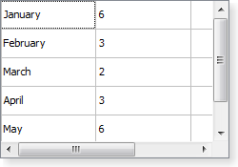
QT SQL: QTABLEVIEW AND QSQLTableModEl
QTableView class provides a default model/view implementation of a table view.
With this widget QSQLTableModel can be used.

Slide 275
QT SQL: QSQLTableModE EXAMPLE
QSqlTableModel *model
= new QSqlTableModel(
parentObject, database);
model->setTable("employee");
model->setEditStrategy(
QSqlTableModel::OnManualSubmit);
model->select();
model->setHeaderData(
0, Qt::Horizontal, "ID");
model->setHeaderData(
1, Qt::Horizontal, "Name");
model->setHeaderData(
2, Qt::Horizontal, "Salary");
QTableView *view = new QTableView; view->setModel(model);
// don't show the ID
view->hideColumn(0);
view->show();

Slide 276
QT SQL: SUMMARY
Qt SQL Layers
QDatabase
QQuery
QTableView, QSQLTableModel

Slide 277
QT SQL
QUESTIONS?

Slide 278
QT TEST
Qt Test is a special testing framework to test Qt Classes:
Lightweight: Qt Test consists of about 6000 lines of code and 60 exported symbols.
Self-contained: Qt Test requires only a few symbols from the Qt Core module for non-gui testing.
Rapid testing: Qt Test needs no special test-runners; no special registration for tests.
Data-driven testing: a test can be executed multiple times with different test data.

Slide 279
QT TEST
Qt Test:
Basic GUI testing: Qt Test offers functionality for mouse and keyboard simulation.
Benchmarking: Qt Test supports benchmarking and provides several measurement back-ends.
IDE friendly: Qt Test outputs messages that can be interpreted by Visual Studio and KDevelop.
Thread-safety: The error reporting is thread safe and atomic.
Type-safety: Extensive use of templates prevent errors introduced by implicit type casting.

Slide 280
QT TEST: DEMO
Demo:
Creating Qt Test Project
Tests running via slots
Qt Test definitions

Slide 281
QT TEST: Compare methods
QVERIFY is used to verify Boolean expression
QVERIFY2 provides an additional description
QCOMPARE is used to compare values.
QString str = "Hello";
QVERIFY(str.toUpper() == "HELLO");
QVERIFY2(true, "Error description");
QCOMPARE(
str.toUpper(),
QString("HELLO")
);

Slide 282
QT TEST: BECHMARKS
The code inside the QBENCHMARK macro will be measured, and possibly repeated several times in order to get an accurate measurement.
QString str1 = QLatin1String(
"This is a test string"
);
QString str2 = QLatin1String(
"This is a test string"
);
QCOMPARE(
str1.localeAwareCompare(str2), 0
);
QBENCHMARK {
str1.localeAwareCompare(str2);
}

Slide 283
QT TEST: DATA-DRIVEN TESTING
Qt Test supports adding test data to a test function.
class TestQString : public QObject { Q_OBJECT
private slots:
void toUpper_data();
void toUpper();
};

Slide 284
QT TEST: DATA-DRIVEN TESTING
void TestQString::toUpper_data() {
QTest::addColumn<QString>(
"string");
QTest::addColumn<QString>(
"result");
QTest::newRow("all lower")
<< "hello" << "HELLO";
QTest::newRow("mixed")
<< "Hello" << "HELLO";
QTest::newRow("all upper")
<< "HELLO" << "HELLO";
}
void TestQString::toUpper() {
QFETCH(QString, string);
QFETCH(QString, result);
QCOMPARE(string.toUpper(), result);
}

Slide 285
QT TEST: SUMMARY
Qt Tests
Compare methods
Benchmarks
Data-driven testing

Slide 286
QT TEST
QUESTIONS?

Slide 287
QT QUICK AND QML
Qt Quick is a special module for rapid GUI applications development.
Qt Quick is used mainly for creating UI for tablet/mobile/embedded devices.
But you can also create desktop GUI application.
Qt Quick uses special language QML (≈ CSS + JavaScript) for declarative UI definition, but bases on C++ backend.
QML is a bridge between designers and developers.

Slide 288
QT QUICK AND QML: Modules
Qt Quick (QT += quick) – Qt Quick core, contains only main features and controls.
Qt QML (QT += qml) – QML Support.
You can use Qt Quick with the classical Qt Widgets Module (but not all controls are available via QML): QT += qml quick widgets

Slide 289
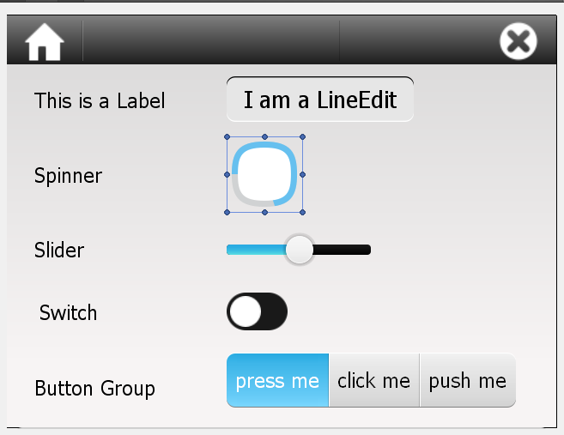
QT QUICK
Qt Quick contains a lot of graphical features: animations, shades, etc.
Qt Quick was designed specifically for touch-driven user-interfaces.
All controls are rectangles by itself for the better look-and-feed on tablet/mobile/embeddable devices.

Slide 290
QML
QML is declarative CSS-like and JavaScript-like language.
All QML files are placed in Qt resources files.
import statement allow you to use necessary controls in your QML script.
Properties of Qt C++ classes can be set in QML scripts.
import QtQuick 2.6
import QtQuick.Window 2.2
Window {
visible: true
width: 640
height: 480
title: qsTr("Hello World")
}

Slide 291
QML: HoW TO RUN
To load files from resources you can use QUrl class.
QQmlApplicationEngine class is used to create GUI from QML files.
QApplication app(argc, argv);
QQmlApplicationEngine engine; engine.load( QUrl(QStringLiteral( "qrc:/main.qml"
))
);
return app.exec();

Slide 292
QML: SYNTAX
You can define inner objects n your form.
QML also supports comments.
QML has built-in types like colors, sizes, rects, points, matrices, fonts.
All objects might have an id.
import QtQuick 2.6
import QtQuick.Window 2.2
Window {
// to show parent window
visible: true
Rectangle {
id: rect1
x: 50
y: 50
width: 100
height: 100
color: "#ff0000"
}
}

Slide 293
QML: SYNTAX
All QML objects can have handlers on specific events.
These handlers can be written as usual JavaScript functions.
System functions and constants can be accessed via "Qt.".
Button {
x: 0
y: 0
width: 20
height: 20
onClicked: function() {
rect1.visible = false;
}
onDestroyed: Qt.quit();
}

Slide 294
QML: DEMO
Demo:
Creating Qt Quick projects
.pro-files settings
QML files: location and syntax
Qt Designer for Qt Quick projects

Slide 295
qT QUICK AND Qml: SUMMARY
Qt Quick
Qt Quick modules
QML
QML syntax

Slide 296
qml
QUESTIONS?

Slide 297
summary
Qt Overview
Qt Language
Containers and QString
Slots and signals
GUI Widgets
Properties
Events
Dialogs
OS Features
Qt SQL
Qt Test
Quick and QML

Slide 298
SUMMARY
QUESTIONS?

